Slide 1

Annual Membership Meeting
November 22, 2020

Slide 2
Agenda
Election of Board Members
Treasurer’s Report
Accomplishments from Past Year
Looking Ahead to Next Year

Slide 3
Elections
Board Consists of 7 Members
  (4) Officers (President, VP, Secretary, Treasurer)
  (3) At-Large Members
  Each Position is a Two Year Term
Vacancies
  Secretary
  (2) At-Large Members

Slide 4
Elections
Previously Volunteered Slate of Candidates
  Secretary: Becky Retzer
  At-Large: Larry Bloomfield, Rick Forrester
Any Other Nominations?
Vote

Slide 5
Treasurer’s Report – Income
 | 2019 | Jan – Sep 2020
Contributions and Support
Earthshare | 899.70 | 1,078.80
Employer Match | 500.00 | 1,125.00
General Donations | 11,451.29 | 9,953.83
Grants to the General Fund | 1091.00 | 5,670.00
In Kind Donations | 2,918.95
Kroger Card | 538.40 | 613.59
Membership Dues | 6,005.00 | 7,512.00
Pipe Safe Donations | 802.88 | 1,086.17
Restricted Grants – Trail | 12,000.00 | 21,825.24
Total Contributions / Support | $36,207.22 | $48,864.63
Fundraising Events | 6,700.60
Reimbursement of Shared Expenses | 512.04 | 503.79
Sales | 6.00
Total Income | $43,425.86 | $49,368.42
 | 40th Anniversary Event | Grants

Slide 6
Treasurer’s Report – Expenses
 | 2019 | 2019 Share | Jan – Sep 2020
Programs | $22,949 | 37% | $26,997
Special Projects | $24,701 | 40% | $19,255
Trail Maintenance | $4,872 | 8% | $4,880
Administration | $6,792 | 11% | $6,824
Marketing | $2,888 | 5% | $2,109
Total Expenses | $62,202 | 100% | $60,065

Slide 7
Treasurer’s Report
Programs Expenses
 | 2019 | Jan – Sep 2020
Kiosks and Information Signs | 495 | 818
Landscaping & Reforestation | 1,266 | 618
Memorial Benches | 1,160 | 9,954
Potable Restrooms | 6,604 | 7,389
Trail & Traffic Signs & Painting | 5,202 | 1,404
Trail Blowing | 2,233 | 779
Trail Sentinel | 289 | -0-
Trail Use Monitoring | 2,500 | 5,235
Tree & Invasives Control | 3,200 | 800
Total Programs Expenses | $22,949 | $26,997

Slide 8
Treasurer’s Report
Special Projects Expenses
 | 2019 | Jan – Sep 2020
Corwin Kiosk | 6,988
Corwin Shelter | 1,646 | 14,907
LMSP 40th Anniversary Festival | 5,881
New Fence Installation | 8,113
Dangerous Intersection LED Stop Signs | 2,073 | 4,389
Total Special Projects | $24,701 | $19,255

Slide 9
Treasurer’s Report
Trail Maintenance Expenses
 | 2019 | Jan – Sep 2020
Equipment Purchase & Rental |  | 916
Equip Storage & Maintenance | 2,914 | 2,517
Fence Repair & Maintenance | 1,473 | 348
General Trail Maintenance | 485 | 1,100
Total Trail Maintenance | $4,872 | $4,880

Slide 10
Treasurer’s Report
Administration Expenses
 | 2019 | Jan – Sep 2020
Administrative Expenses | 903 | 1,887
Annual Meeting | 335
Legal and Insurance | 4,919 | 4,613
Banking Services | 635 | 324
Total Administration | $6,792 | $6,824

Slide 11
FLMSP By the Numbers
vs. 12/31/19
3,759 Volunteer Hours - 17%
390 Members + 25%
2,392 Receive our TrailMail - 2%
1,655 Facebook Followers + 2%
57 Twitter Followers + 0%

Slide 12
Trail Usage
*
Notes:
This is the second year that we have contracted with Tri-State Trails to collect our count data. Tri-State Trails collects trail data on numerous trails in Ohio, Kentucky and Indiana around the Cincinnati area.
This year we purchased a new permanent counter that allows us see daily data from the convenience of the cloud. That is how we are able to project our 2020 year end total at this time, an increase of 43% from last year.

Slide 13
FLMSP Mission
Create a rewarding user experience on the Little Miami State Park trail by improving its:
  Safety
  Condition
  Convenience and
  Beauty
… in a manner consistent with its natural river setting.

Slide 14
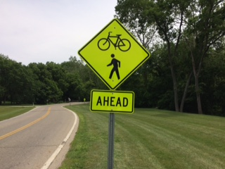
Accomplishments - Safety
Intersection painting and signage
Intersection site line clearance
Flashing stop signs
Fence building and repairs
Sentinel program
Helmet give-away
Notes:
49 intersections along the 50 miles of the trail. 16 intersections have relatively low traffic volume. Of the remaining 33 intersections, all now have improved ladder-style crosswalks. 90% of the intersections have road signage both at the intersection and 100’ before. FLMSP was planning on spending considerable money to make this happen, but Don Mills was able to negotiate with most of the municipalities for them to pick up the cost.
Every year, we look at the intersections to insure we have broad sight lines so trail users and vehicular traffic can see each other.
We have installed flashing stop signs at two busy intersections – Stubbs Mill Rd and Fosters.
Our fencing crew repaired several fences along the trail, mostly due to tree falling on them. To make future repairs easier, the fence crew consolidated tools and materials from three different location into our tool cache near South Lebanon.
The sentinel program has 13 volunteers who travel the trail in identifying vests. They look for safety issues, graffiti, garbage and offer assistance and advice to trail users. In 2020, they collectively logged in 350 volunteer hours.
In June, we hosted a youth helmet give-away program at Nisbet Park in Loveland. A total of 58 helmets were given away. Another give-away is tentatively planned for next year.

Slide 15
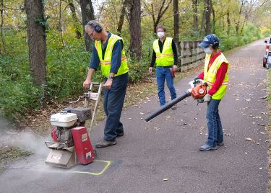
Accomplishments – Trail Condition
Trail Blowing
Bump Grinding
Crack Filling
ODNR culvert and ditch clearing
Notes:
We have two 25 hp towable blowers that clear the trail after storms and especially now, when the leaves are dropping. Our team of volunteers put on thousands of miles every year to help keep the trail clear.
In mid October, 11 volunteers ground down 147 bumps along the entire 50 mile long trail. This makes for a smooth trail for all users.
Crack filling is a job best done in the winter will less traffic. We plan to fill cracks in the next couple of months.
Special thanks to ODNR, who cleared many ditches and culverts in the Oregonia, Kings Mill and Loveland areas. Flooding, and the slippery mud it brings on the trail, was better in 2020 compared to 2019, but this is a never ending task.

Slide 16
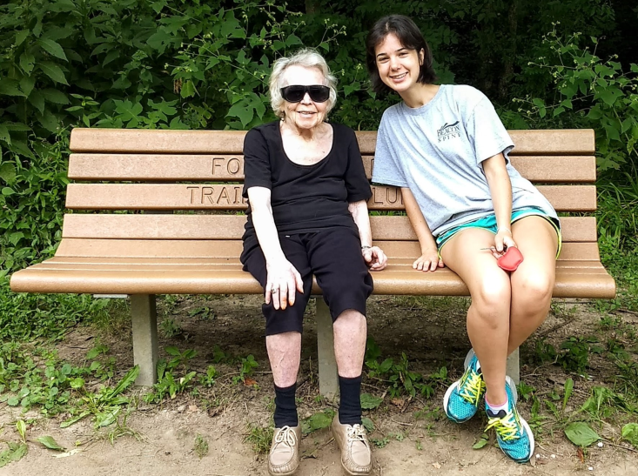
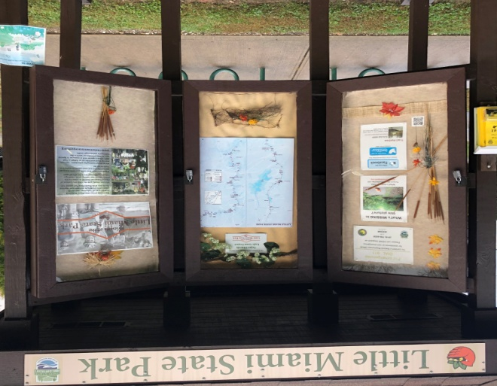
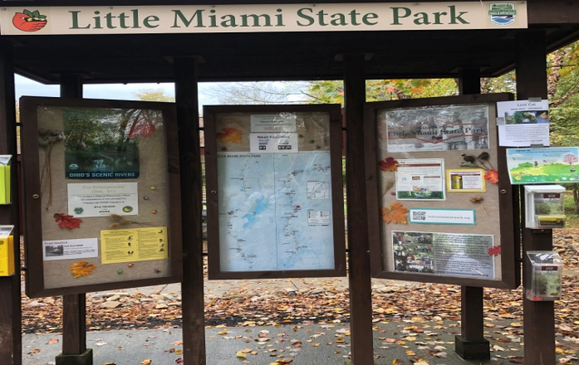
Accomplishments – Trail Convenience
Portable Toilets
Benches
Kiosks
Notes:
Provide seasonal and year-round portable toilets at the following locations: Spring Valley, Corwin, Oregonia, Morrow, South Lebanon, Fosters and Miamiville.
Our goal is to have at least one bench along every two mile segment on the trail. 2020 has been a banner year, with donations for ten benches. There is only one location left currently, at mile marker 8.7 (approximately 2 miles south of Spring Valley).
There are currently 7 kiosks (in Milford, Miamiville, Loveland, Fosters, Lebanon Spur, South Lebanon and Corwin) that are maintained by 6 volunteers. This year, we installed recognition/memorial plaques on six of these kiosks to recognize the generous donations of those who made these kiosks possible.

Slide 17
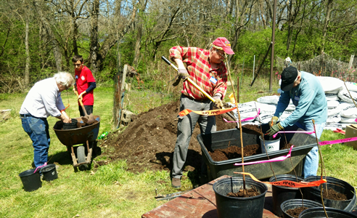
Accomplishments – Trail Beauty
Tree Planting
Invasive Control
Notes:
After planting hundreds of trees for each of the past several years, we were unable to plant any additional trees this year. Our source, the Warren County Soil and Water Conservation District suspended sales this spring due to Covid-19 restrictions. We anticipate resuming this important work next year.
Volunteers actively go out and reduce invasive species on the trail. This year, that effort has included going after Honeysuckle and Ailanthus (Tree of Heaven).

Slide 18
Communication
TrailMail
Facebook
Twitter
Hotline
Local Jurisdictions
Notes:
Our wildly popular TrailMail newsletter is published ten times a year and goes out to nearly 2,400 subscribers. It features articles about upcoming changes on the trail, its history and its beauty. We also publish articles on safety, trail maintenance and volunteer needs. If you would like to contribute, please write to TrailMail@flmsp.org.
Our Facebook and Twitter presence has grown this year. These social media platforms have been especially popular at times when there have been intermittent trail closures due to maintenance or upgrades. We provide daily updates here so we don’t clog up your email inbox.
If you’re on the trail and see a tree that’s blocking the path, who you gonna call? Not the ghostbusters, but our Trail Hotline. The phone number is 513-212-6958. So far in 2020, we’ve received 120 hotline calls.
Not only do we need to communicate with trail users, but we also need to communicate with the municipalities along the trail. A great example is our involvement with local jurisdictions to get improved safety crosswalks along with signage at the intersections and 100’ before. In all, the Little Miami State Park goes through four counties and 17 villages, townships and cities.

Slide 19
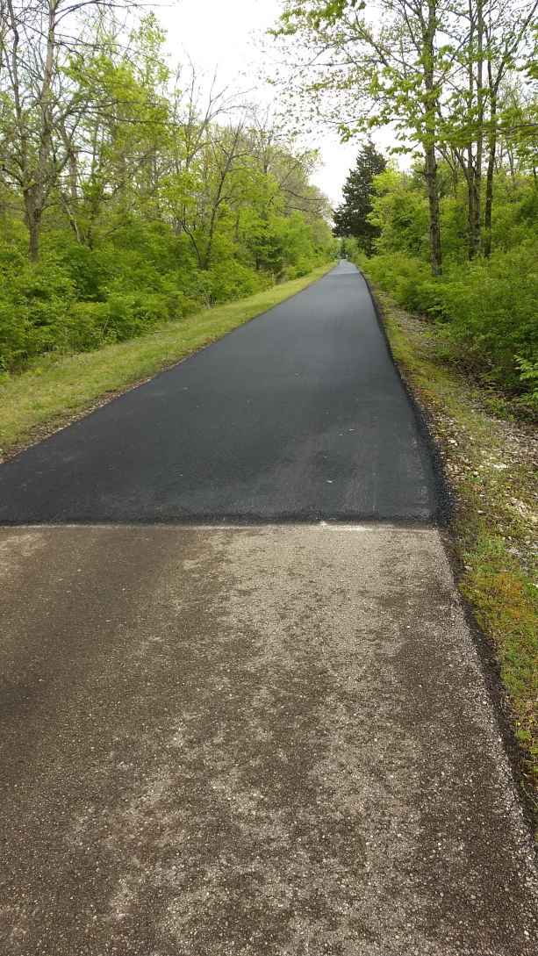
Legislative Involvement
2018 - 2020 Ohio Budget
  $200,000 in community-based capital
  Paved 1.6 miles south of Morrow
2020 – 2022 Ohio Budget
  Hopeful for additional funding during the current lame duck session.
Notes:
Thanks in part to the grass roots effort from our membership, FLMSP was able to get $200,000 in funding from the state legislature to pave the worst section of pavement of the trail – 1.6 miles from Morrow heading south. This was included in the previous biennial state budget.
The current biennial state budget is still not finalized. The latest word from Senator Wilson’s office is that our current request will be part of the budget under consideration in the current lame-duck session.

Slide 20
Looking To Next Year
Corwin Shelter
More kiosks and new brochures
Fosters Intersection Reroute
Improved Volunteer Relations
Notes:
A partnership was formed between the Village of Corwin, ODNR and FLMSP to purchase and erect a 16’ x 24’ shelter at the Corwin rest area. Corwin and FLMSP purchased the structure and ODNR is in the process of installing it. Currently, the footers have been poured. Erection of the structure is expected over the next month or so.
In 2021, we anticipate having two additional kiosks, in Morrow and Spring Valley. We also anticipate having a redesigned map and brochure.
Starting in June of 2021, the 3C bridge that passes over the trail near Fosters will be closed for maintenance. Traffic will be diverted to Old 3C highway that crosses the trail at the Monkey Bar. This is already a crowded intersection and between trail traffic and road traffic. ODOT, ODNR and Hamilton Township are working on a solution to keep everyone safe. This will likely result in a re-route of the trail in the area and coordinated traffic lighting. Count on us to pass along the final decision as soon as it’s made.
In 2020, members of the board actively looked at improving our volunteer relations. We explored software options and even tested one version. We still haven’t found a good software solution yet, but continue to be on the lookout. Meanwhile, we hope to make this a focus area for our organization this upcoming year. If interested, please get in touch with Becky Retzer.

